Slide 1
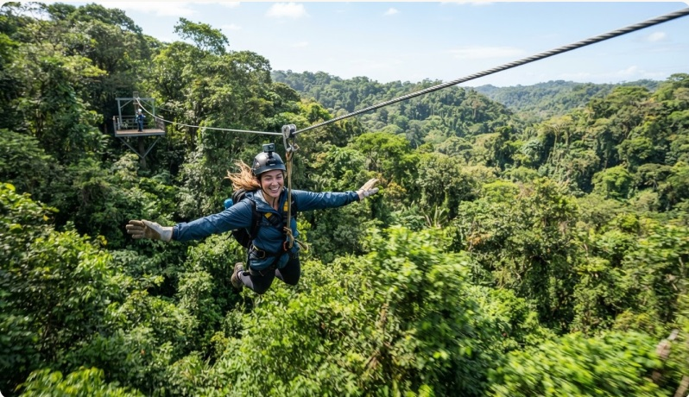
ADVENTURE ESCAPE SA
XHAW5112 • DESIGN SHOWCASE
WEBSITE + MOBILE APPLICATION
ADVENTURE
ESCAPE SA
Interface designs for discovering outdoor experiences,
selecting bookings and requesting a quotation.
PRESENTED BY
Blessings Massiye • Nqubeko Mthetwa

Slide 2
01 • PROJECT FOUNDATION
PRESENTER • BLESSINGS MASSIYE
The brief
2024
One place to discover, compare
and request guided outdoor
adventures.
ESTABLISHED IN SOUTH AFRICA
OPERATING THROUGHOUT THE WESTERN CAPE
Liam Daniels’ SME serves individuals, families, schools, tourists and corporate groups with professionally guided experiences for all ages and experience levels.
01
Advertise
Show packages, activities, fees and inclusions.
02
Receive requests
Let customers combine multiple bookings.
03
Provide quotations
Apply discounts and present a clear total.
Speaking plan: Blessings — brief, brand and website • Nqubeko — mobile, shared journey and conclusion
XHAW5112 • ADVENTURE ESCAPE SA 02

Slide 3
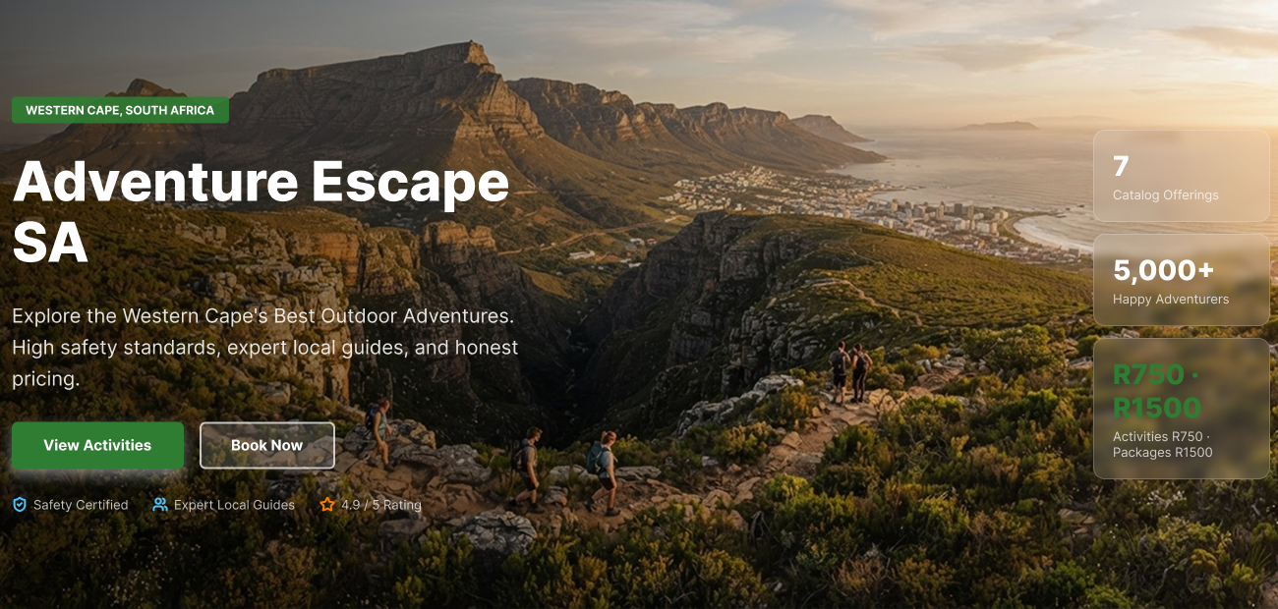
02 • VISUAL DIRECTION
PRESENTER • BLESSINGS MASSIYE
A brand language rooted in the outdoors
COLOUR SYSTEM
Forest green
Trust, nature, navigation • #123B2A
Adventure green
Primary actions and fees • #237A3B
Sunset orange
Energy, totals and emphasis • #F28C18
Warm neutral
Open space and readability • #F7F5EF
Landscape photography carries the brand promise; strong typography and direct actions keep the experience practical.
Aa
Bold sans-serif headings
Clear, compact body copy
Consistent buttons • visible fees • safety cues • simple forms
XHAW5112 • ADVENTURE ESCAPE SA 03

Slide 4
03 • CATALOGUE + PRICING
PRESENTER • BLESSINGS MASSIYE
Seven experiences, two clear price points
ADVENTURE PACKAGES • R1,500 EACH
BOOK MORE • SAVE MORE
Ultimate Adventure Day — full-day multi-activity adventure
Family Explorer Package — fun-filled family experience
Mountain Adventure Package — guided mountain exploration
Corporate Team Challenge — team building for organisations
Automatic
discount tiers
1 booking — standard rate
2 bookings — 5% off
3 bookings — 10% off
4+ bookings — 15% off
INDIVIDUAL ACTIVITIES • R750 EACH
Ziplining Adventure — forest views from the air
Kayaking Experience — guided rivers and lakes
Rock Climbing Session — natural rock-face techniques
The selected adventures and discount are shown before a quotation request.
XHAW5112 • ADVENTURE ESCAPE SA 04

Slide 5
04 • WEBSITE DESIGN
PRESENTER • BLESSINGS MASSIYE
Home page — inspire first, guide next
DESKTOP WIREFRAME • HERO SECTION
A strong first
impression
01 Western Cape imagery establishes place.
02 “View Activities” and “Book Now” provide clear next steps.
03 Safety, guides and ratings support trust.
The right-hand metrics reinforce choice, experience and transparent pricing.
Below the hero: featured adventures → reasons to choose → testimonials → quotation call-to-action
XHAW5112 • ADVENTURE ESCAPE SA 05

Slide 6
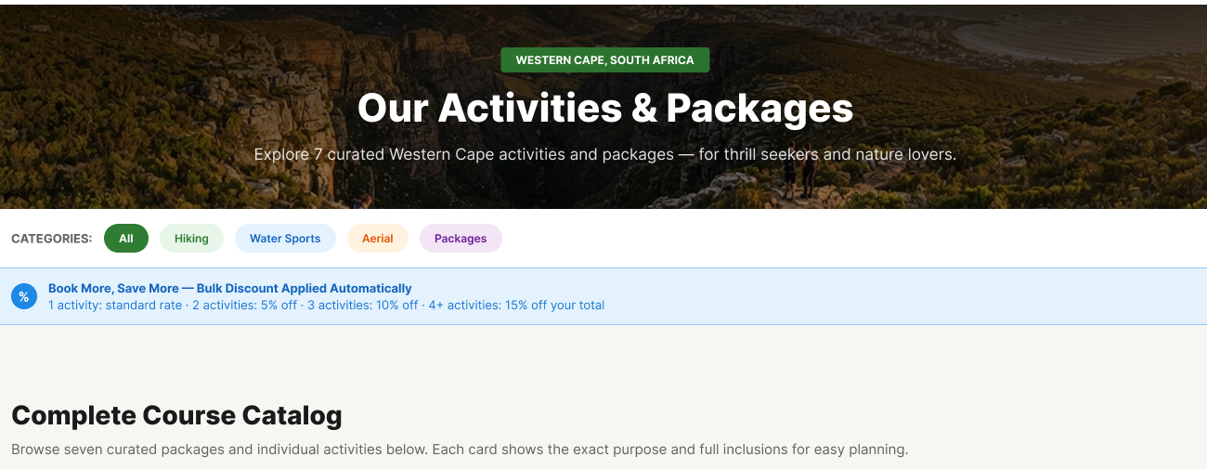
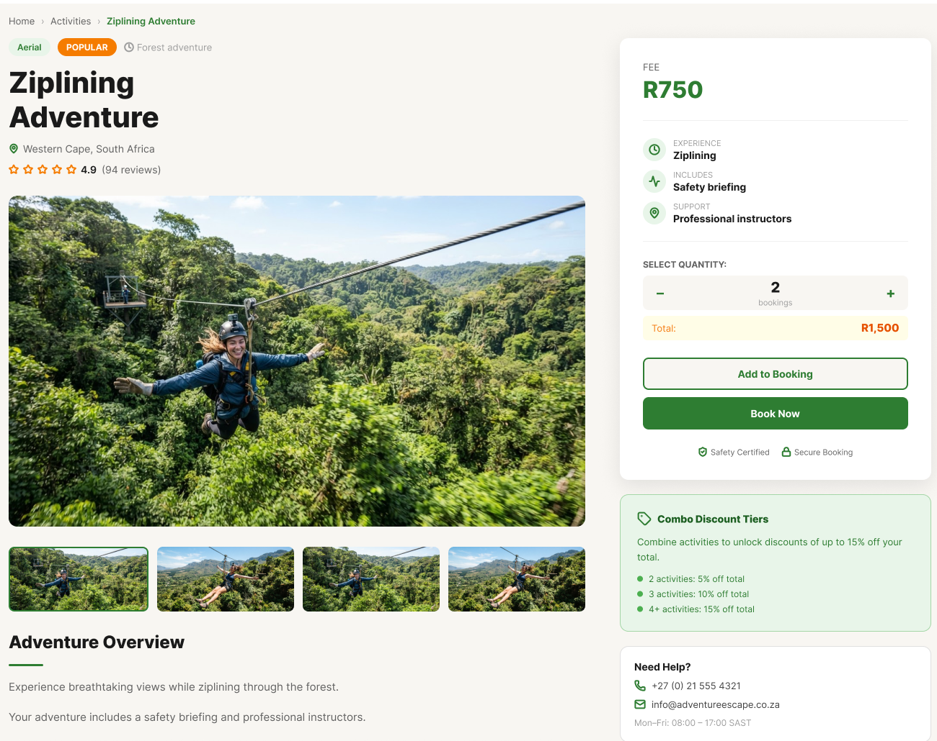
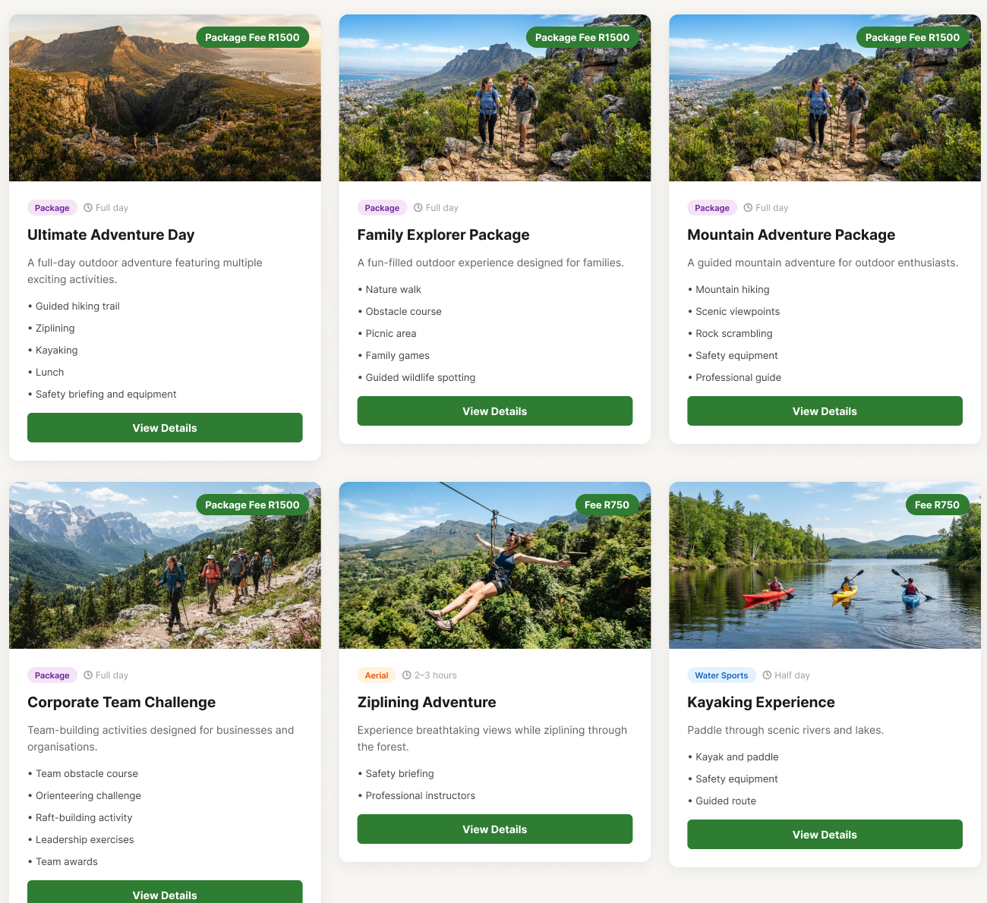
04 • WEBSITE DESIGN
PRESENTER • BLESSINGS MASSIYE
Browse the catalogue, then inspect the details
ACTIVITIES + PACKAGES OVERVIEW
INDIVIDUAL ACTIVITY • ZIPLINING
Category filters, visible fees, inclusion lists and a persistent “View Details” action make comparison direct.
The detail view combines gallery imagery, overview, fee, quantity controls, discount tiers, help details and two booking actions.
XHAW5112 • ADVENTURE ESCAPE SA 06

Slide 7
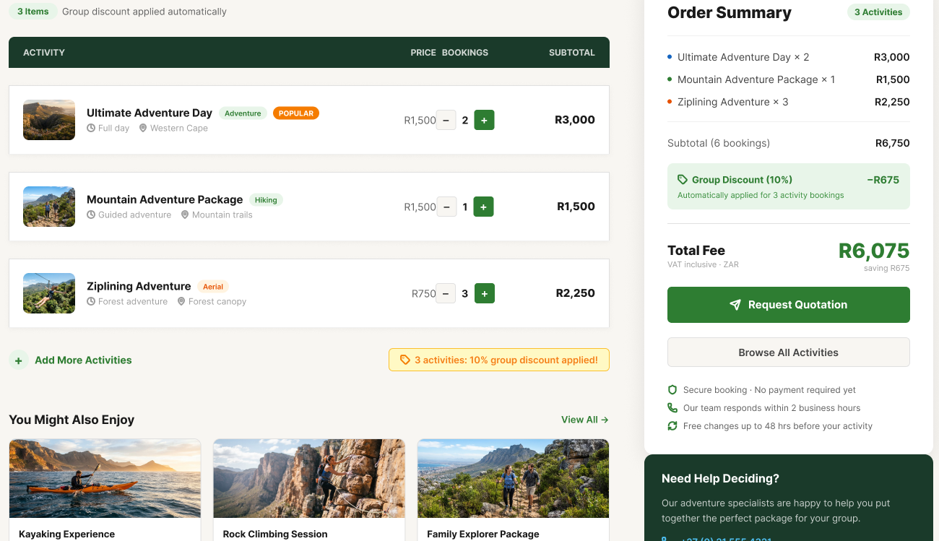
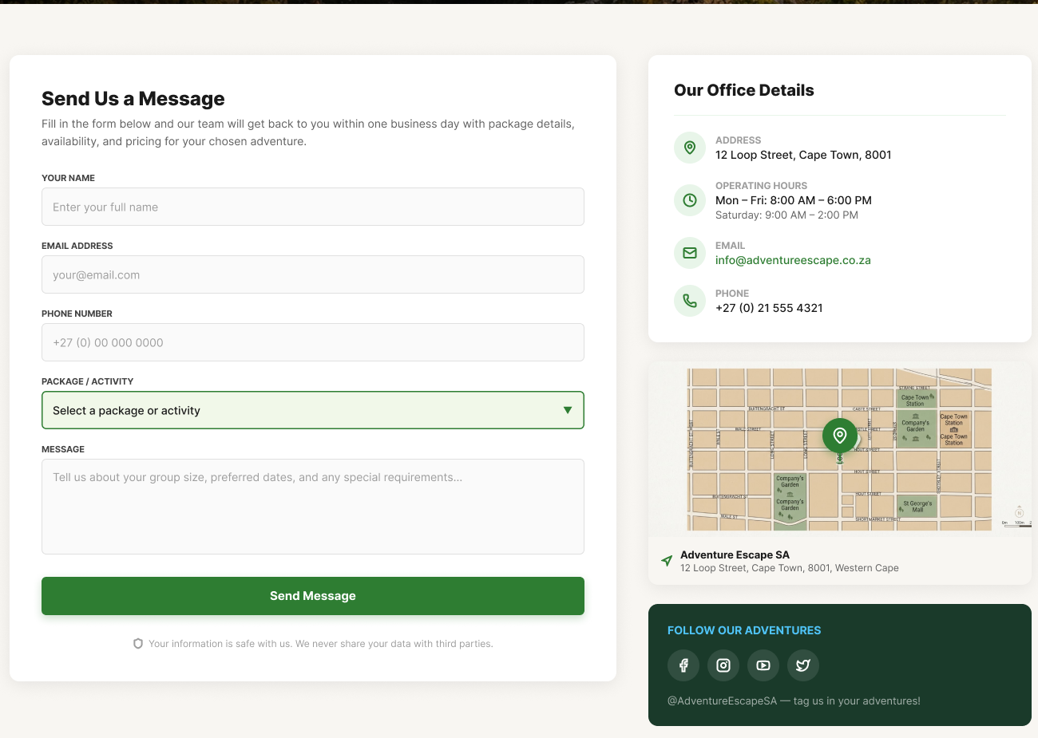
04 • WEBSITE DESIGN
PRESENTER • BLESSINGS MASSIYE
Calculate fees, then request a quotation
FEE CALCULATOR • ORDER SUMMARY
CONTACT + ENQUIRY
• Captures contact, package and message details
• Office hours, map and direct contact options
• One clear enquiry submission action
Example: R6,750 subtotal − 10% group discount (R675) = R6,075 total
XHAW5112 • ADVENTURE ESCAPE SA 07

Slide 8
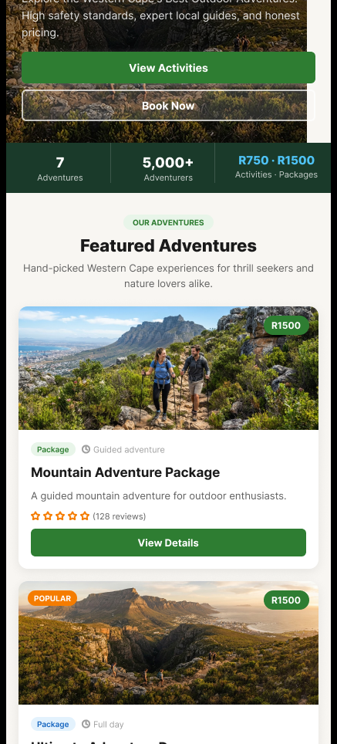
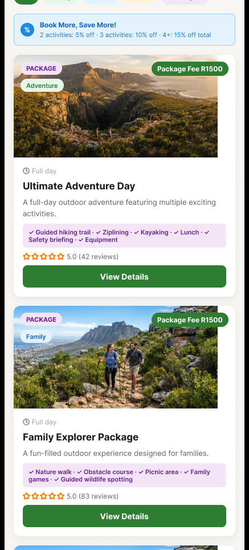
05 • MOBILE APPLICATION
PRESENTER • NQUBEKO MTHETWA
Mobile discovery — the same story, recomposed
HOME SCREEN
ACTIVITIES + PACKAGES
Designed for
smaller screens and
thumb-led navigation.
01 Single-column content replaces desktop grids.
02 Large imagery and full-width actions stay prominent.
03 Home, Activities, Fees, About and Contact remain easy to reach.
Mobile preserves the brand and booking logic while changing the layout—not the meaning.
XHAW5112 • ADVENTURE ESCAPE SA 08

Slide 9
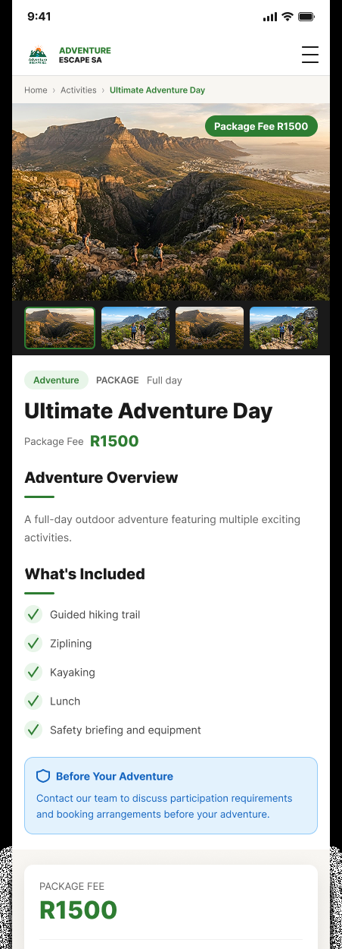
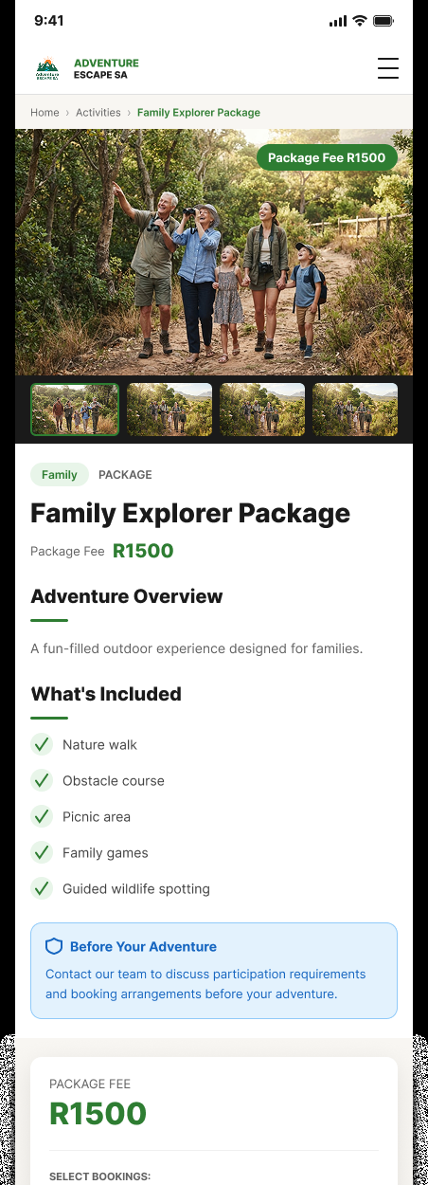
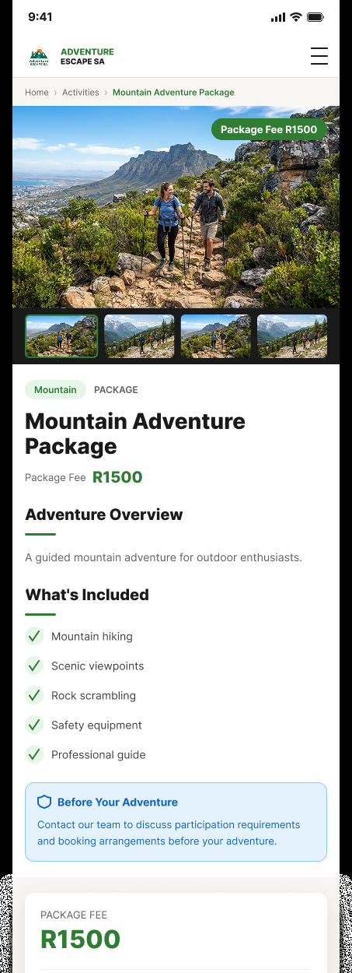
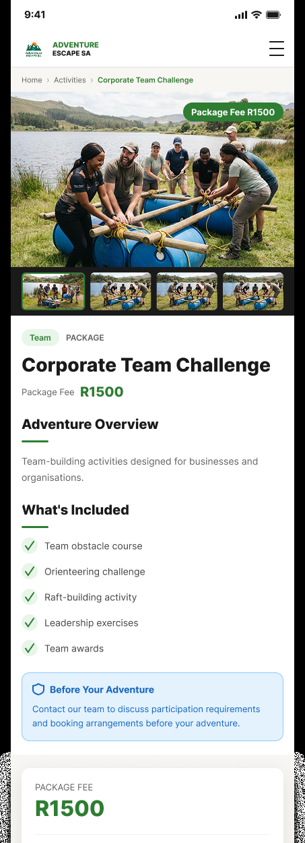
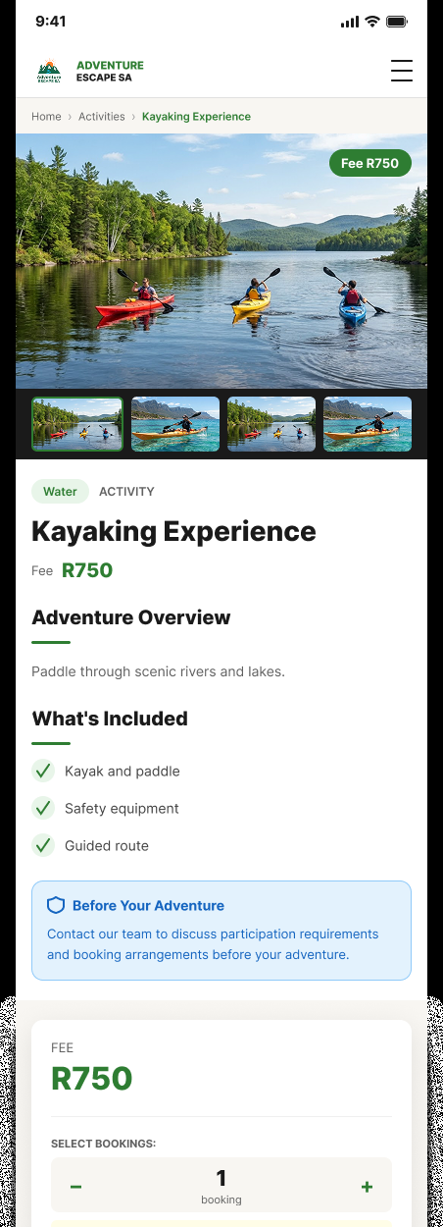
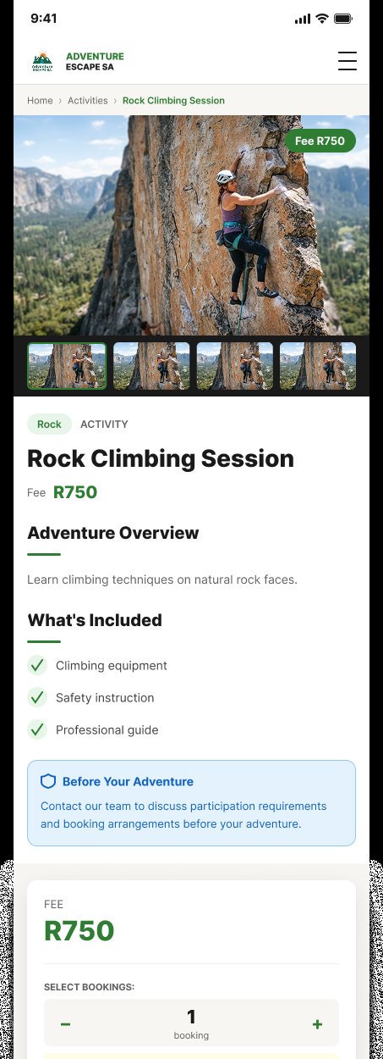
05 • MOBILE APPLICATION
PRESENTER • NQUBEKO MTHETWA
One detail template, six adventures
Shared pattern: gallery → overview → inclusions → fee → quantity → Add to Booking / Book Now
Ultimate Adventure Day
Package • R1,500
Family Explorer
Package • R1,500
Mountain Adventure
Package • R1,500
Corporate Challenge
Package • R1,500
Kayaking Experience
Activity • R750
Rock Climbing Session
Activity • R750
XHAW5112 • ADVENTURE ESCAPE SA 09

Slide 10
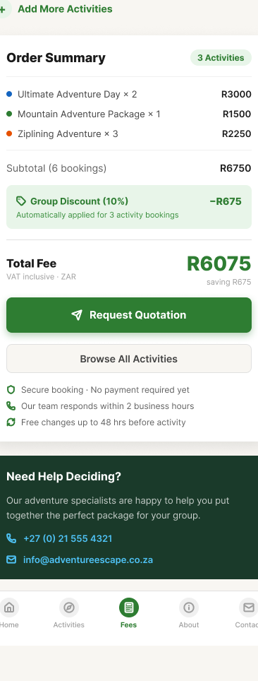
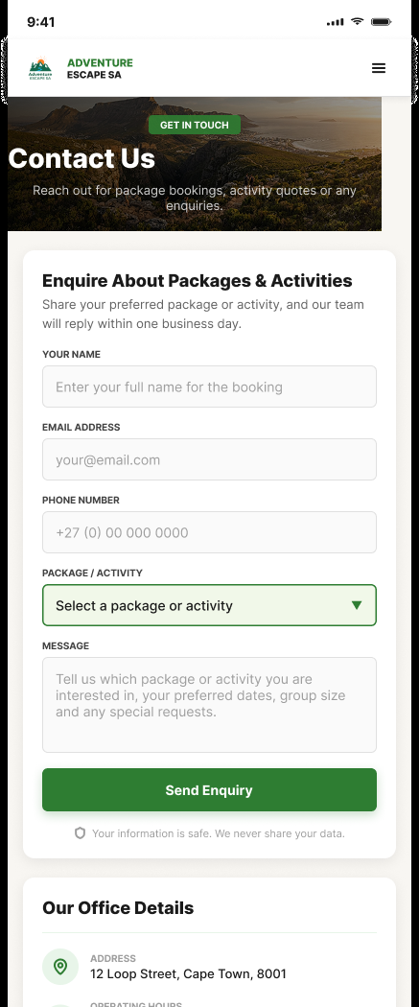
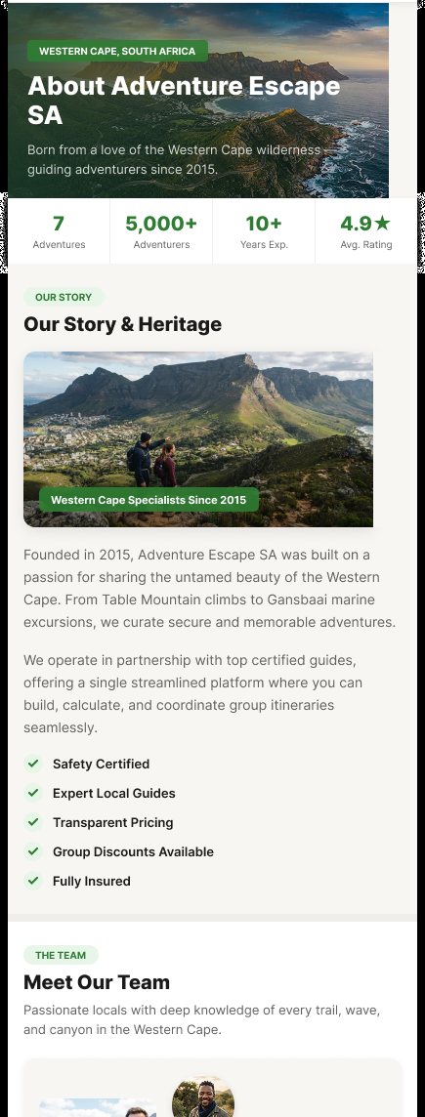
05 • MOBILE APPLICATION
PRESENTER • NQUBEKO MTHETWA
Quote, enquire and build trust on mobile
CALCULATE FEES
CONTACT US
ABOUT US
Essential tasks stay
focused on a narrow
screen.
Fees — quantities, subtotal, discount and total remain together.
Contact — the enquiry form asks only for useful booking details.
About — story, team, mission and values make the SME more credible.
The mobile wireframes keep the same fees, discount rules, content and calls-to-action as the website.
XHAW5112 • ADVENTURE ESCAPE SA 10

Slide 11
06 • SHARED USER EXPERIENCE
PRESENTER • NQUBEKO MTHETWA
One booking journey across both platforms
1
2
3
4
5
Discover
Compare
Select
Save
Request
Home + catalogue
Fees + inclusions
Quantity + booking
Automatic discount
Quotation / enquiry
Consistent across platforms
Responsive by design
• Same seven offerings and fee structure
• Same green-led brand and orange emphasis
• Same quantity, discount and quotation logic
• Same safety, contact and trust information
• Multi-column desktop grids become one column
• Desktop navigation becomes mobile bottom navigation
• Large actions remain visible and easy to tap
• Content order follows the customer’s next decision
Prototype scope: customers request a quotation or enquiry; no online payment is implied.
XHAW5112 • ADVENTURE ESCAPE SA 11

Slide 12
ADVENTURE ESCAPE SA • FINAL SUMMARY
ONE ADVENTURE.
TWO PLATFORMS.
A consistent design for discovering, planning and requesting
Western Cape outdoor experiences—on desktop and mobile.
Clear catalogue • transparent fees • automatic discounts • simple quotation requests
QUESTIONS?
Blessings Massiye • Nqubeko Mthetwa • XHAW5112
CLOSING • NQUBEKO

